Slide 1

Tower Defense

Slide 2








Step 0: What Entities do we need?
Tower
TowerBase
Enemy
Projectiles fired from Tower
Everything to be placed on a Tiled Map!
Map has paths that enemies can walk on
Notes:
Create entitytype enum

Slide 3
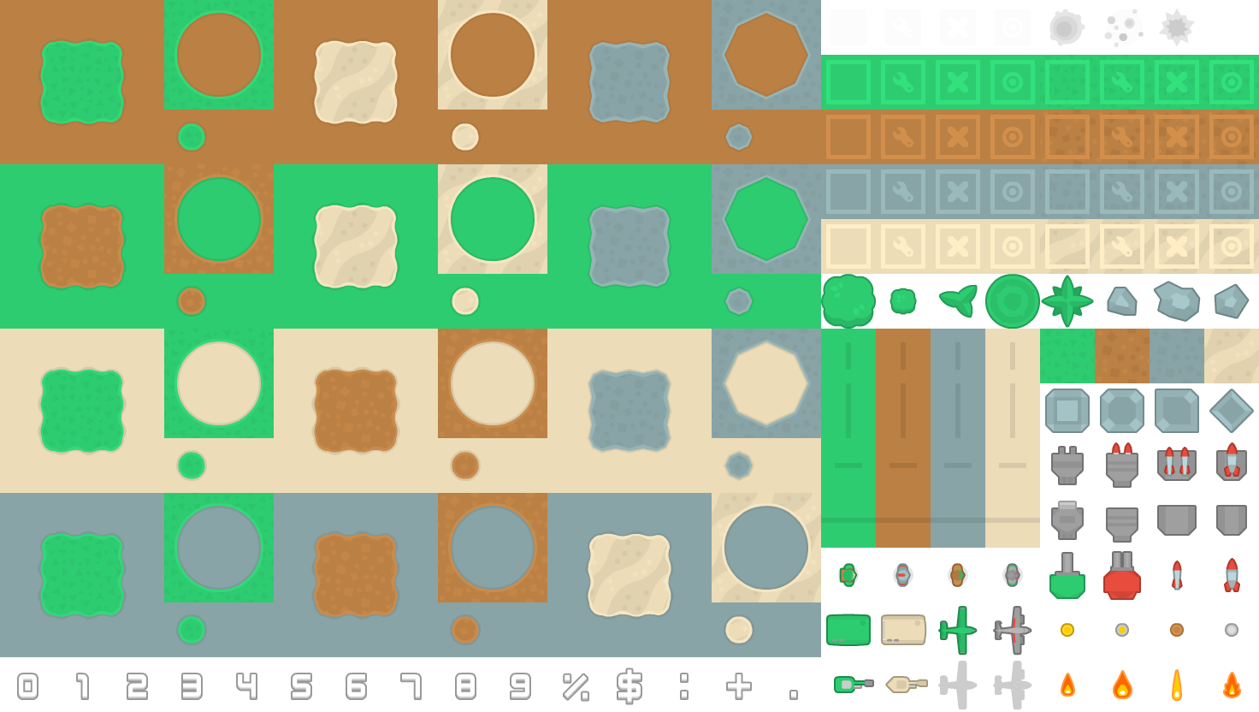
Step 1: Creating a Tiled Map

Slide 4
Step 2: Creating a TowerSelectionBox

Slide 5

TowerSelectionBox
A box needs:
A list of towers
Each tower needs:
Name, image, cost, etc

Slide 6
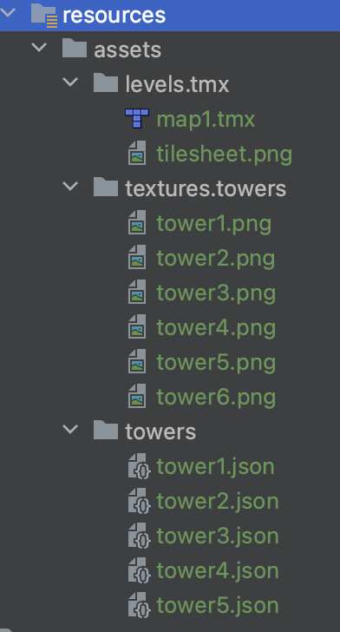
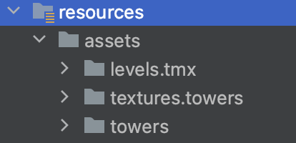
Assets required

Slide 7
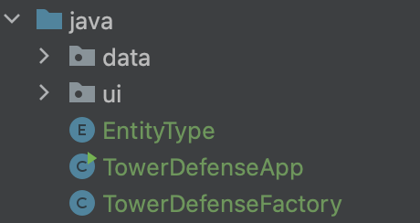
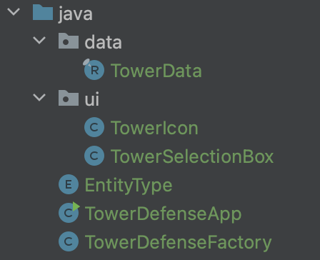
Java files required

Slide 8
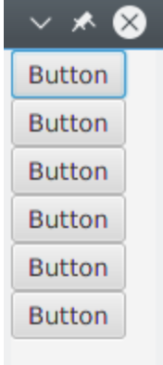

HBox vs VBox
Both layout their children in a singe line
HBox: one single horizontal row from left to right
VBox: one single vertical column from top to bottom

Slide 9
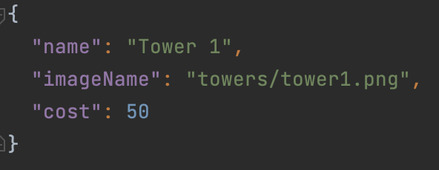
What is JSON?
An easy-to-understand format for storing and moving data
Data is in name-value pairs
Data is separated by commas

